Slide 1
LINUX COMMANDS

Slide 2

FILE CREATION AND EDITING

Slide 3
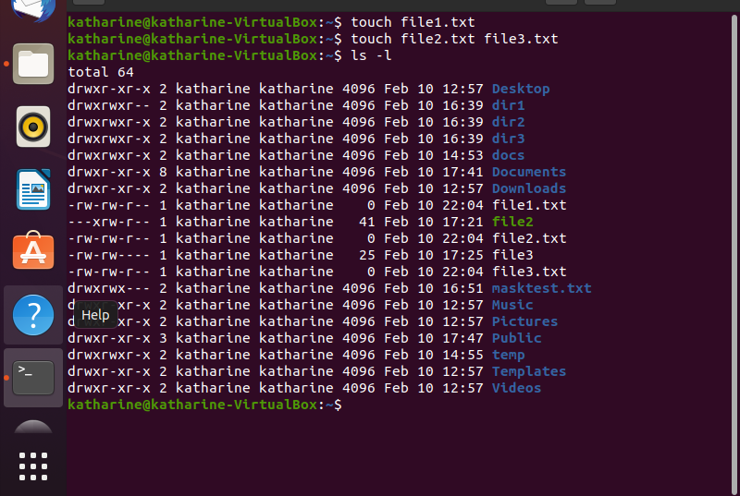
TO CREATE FILES : →touch file1.txt file2.txt file3.txt →ls

Slide 4
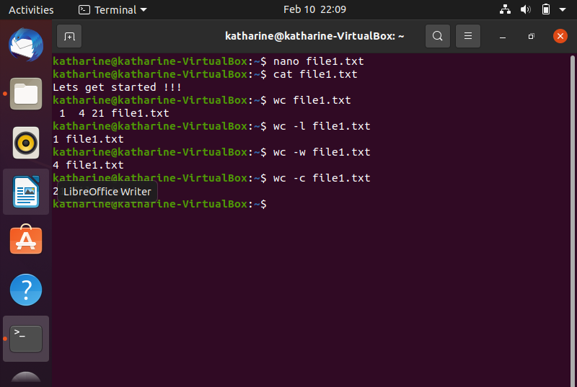
TO EDIT FILE : →nano file1.txt (& enter text (ctrl+s, ctrl+x)) →cat file1.txt (displays file1.txt)

Slide 5
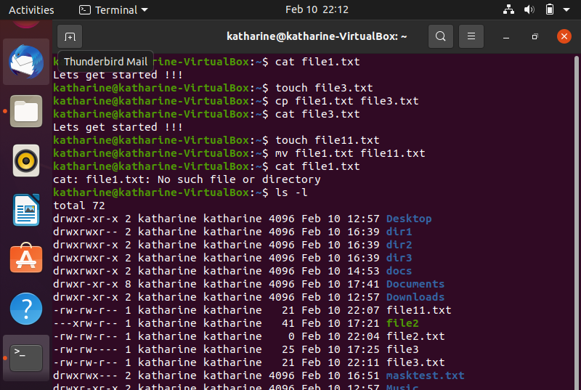
TO MOVE A FILE : →mv filename1 filename2 TO REMOVE A FILE : →rm filename TO COPY A FILE : →cp filename1 filename2

Slide 6
DEFINING PATHS

Slide 7
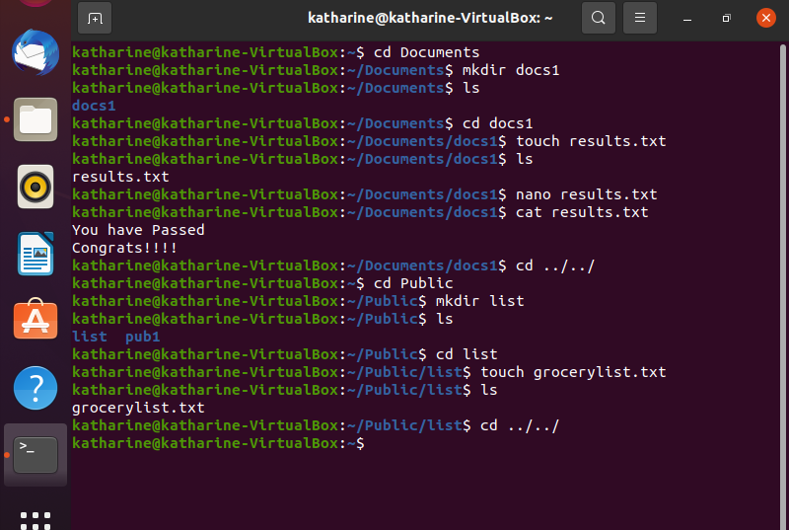
TWO KINDS OF PATHS : 1. Absolute 2. Relative

Slide 8
PERMISSION GRANTS

Slide 9
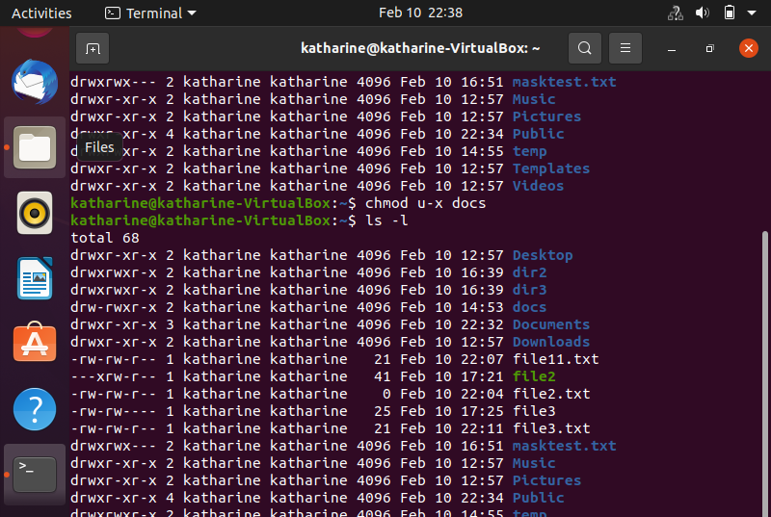
THERE ARE 3 LEVELS OF PERMISSIONS : 1. Owner Permission 2. Group Permission 3. Other World Permission

Slide 10
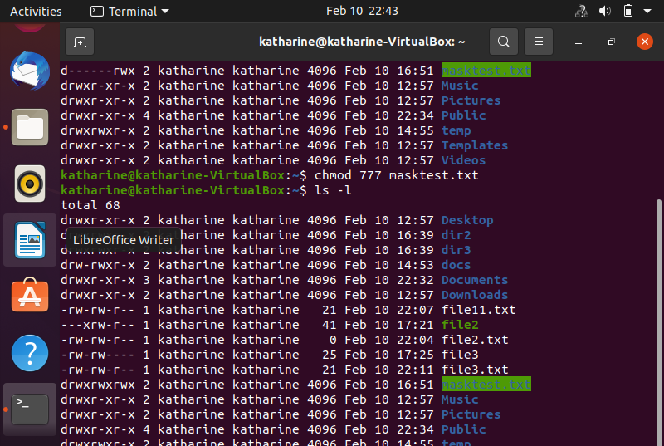
METHODS TO CHANGE THE MODE OF PERMISSION ARE: 1. Symbolic Method 2. Absolute Method

Slide 11
THANKYOU

